Slide 1
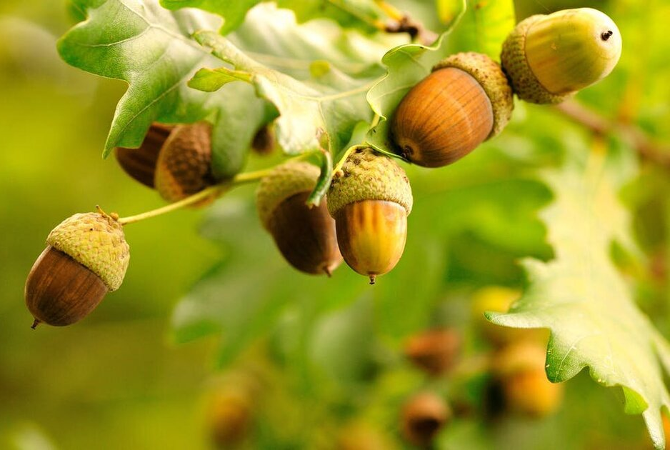
Welcome to Acorn Class

Slide 2
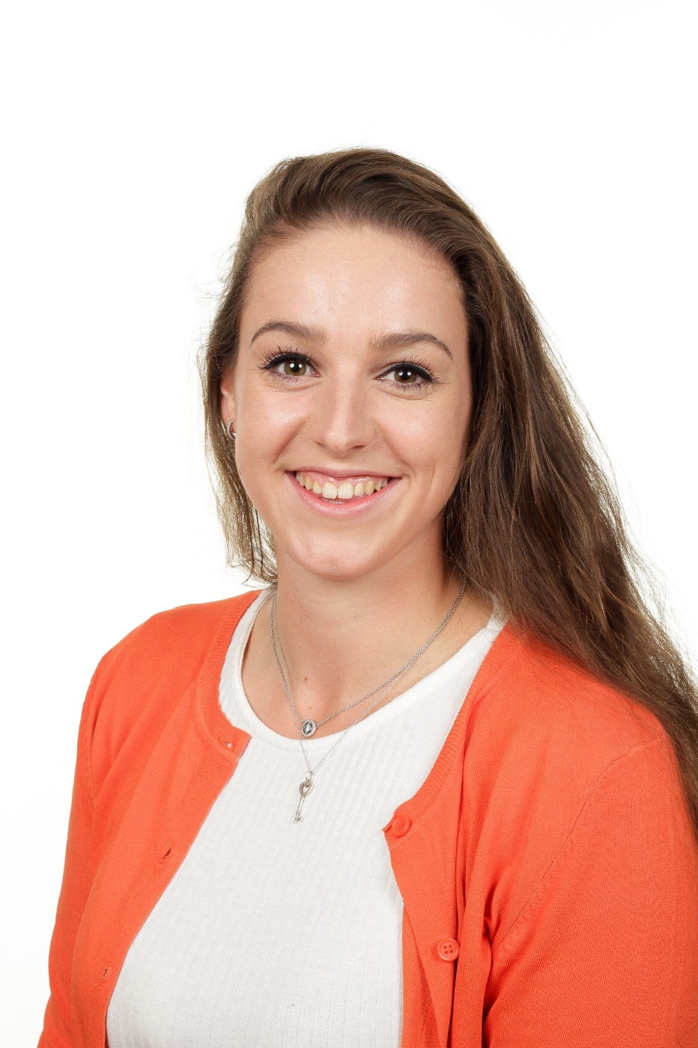
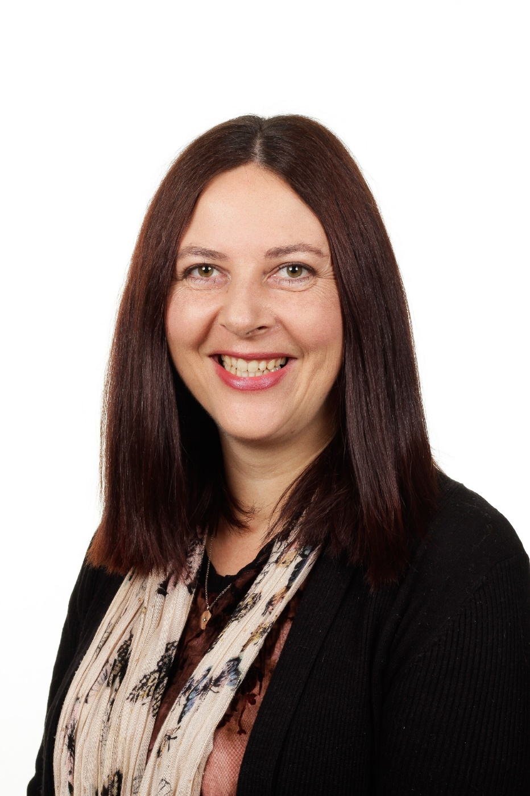
Who is in our classroom?
Mrs Gunn
(Teaching Assistant)
Miss Diggins
(Teacher)

Slide 3
Morning Routine
Children should be dropped at the main gate 8.50am. They will be on the playground until 8.55am when the bell rings.
Acorn class will go into the classroom together ready for registration.
Your child will need their book bag and a labelled water bottle.
A healthy snack will be available at break time.

Slide 4
Lunchtime
Acorn class will have lunch between 12-1.15pm.
Your child is entitled to a free school lunch each day.
If you would prefer, your child can bring in a packed lunch from home with them.

Slide 5
Afternoon Routine
The children will have a daily assembly session from 3.00pm.
Children will be brought to the playground to be collected from the main gate at 3.20pm.
Your child can leave the line when a parent or carer can be clearly seen.
If someone else is collecting your child please make the office aware.

Slide 6
Timetable
Acorn class will have short daily sessions of:
Phonics/literacy
Maths
Topic
Acorn class will have PE on a Monday.
We will have Forest school in Autumn 2 and Summer 1.
Show and Tell will take place on a Thursday.

Slide 7
Reading
Children will be given reading books during the first term.
Children should bring their reading books and records in each day.
We will try to hear your child read each day.
Please try to read at home daily with your child.
Phonics based activities will be sent home when we start more formal phonics lessons.

Slide 8
We look forward to welcoming your child into Acorn Class.
If you have any further questions please feel free to contact the school office or Miss Diggins.

