Slide 1
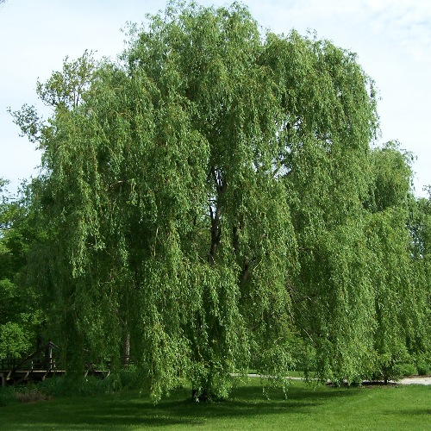
Welcome to Willow Class
This Photo by Unknown Author is licensed under CC BY-SA

Slide 2
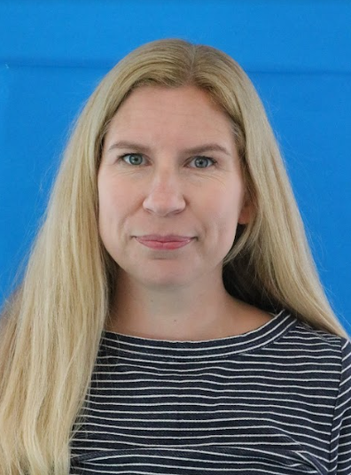
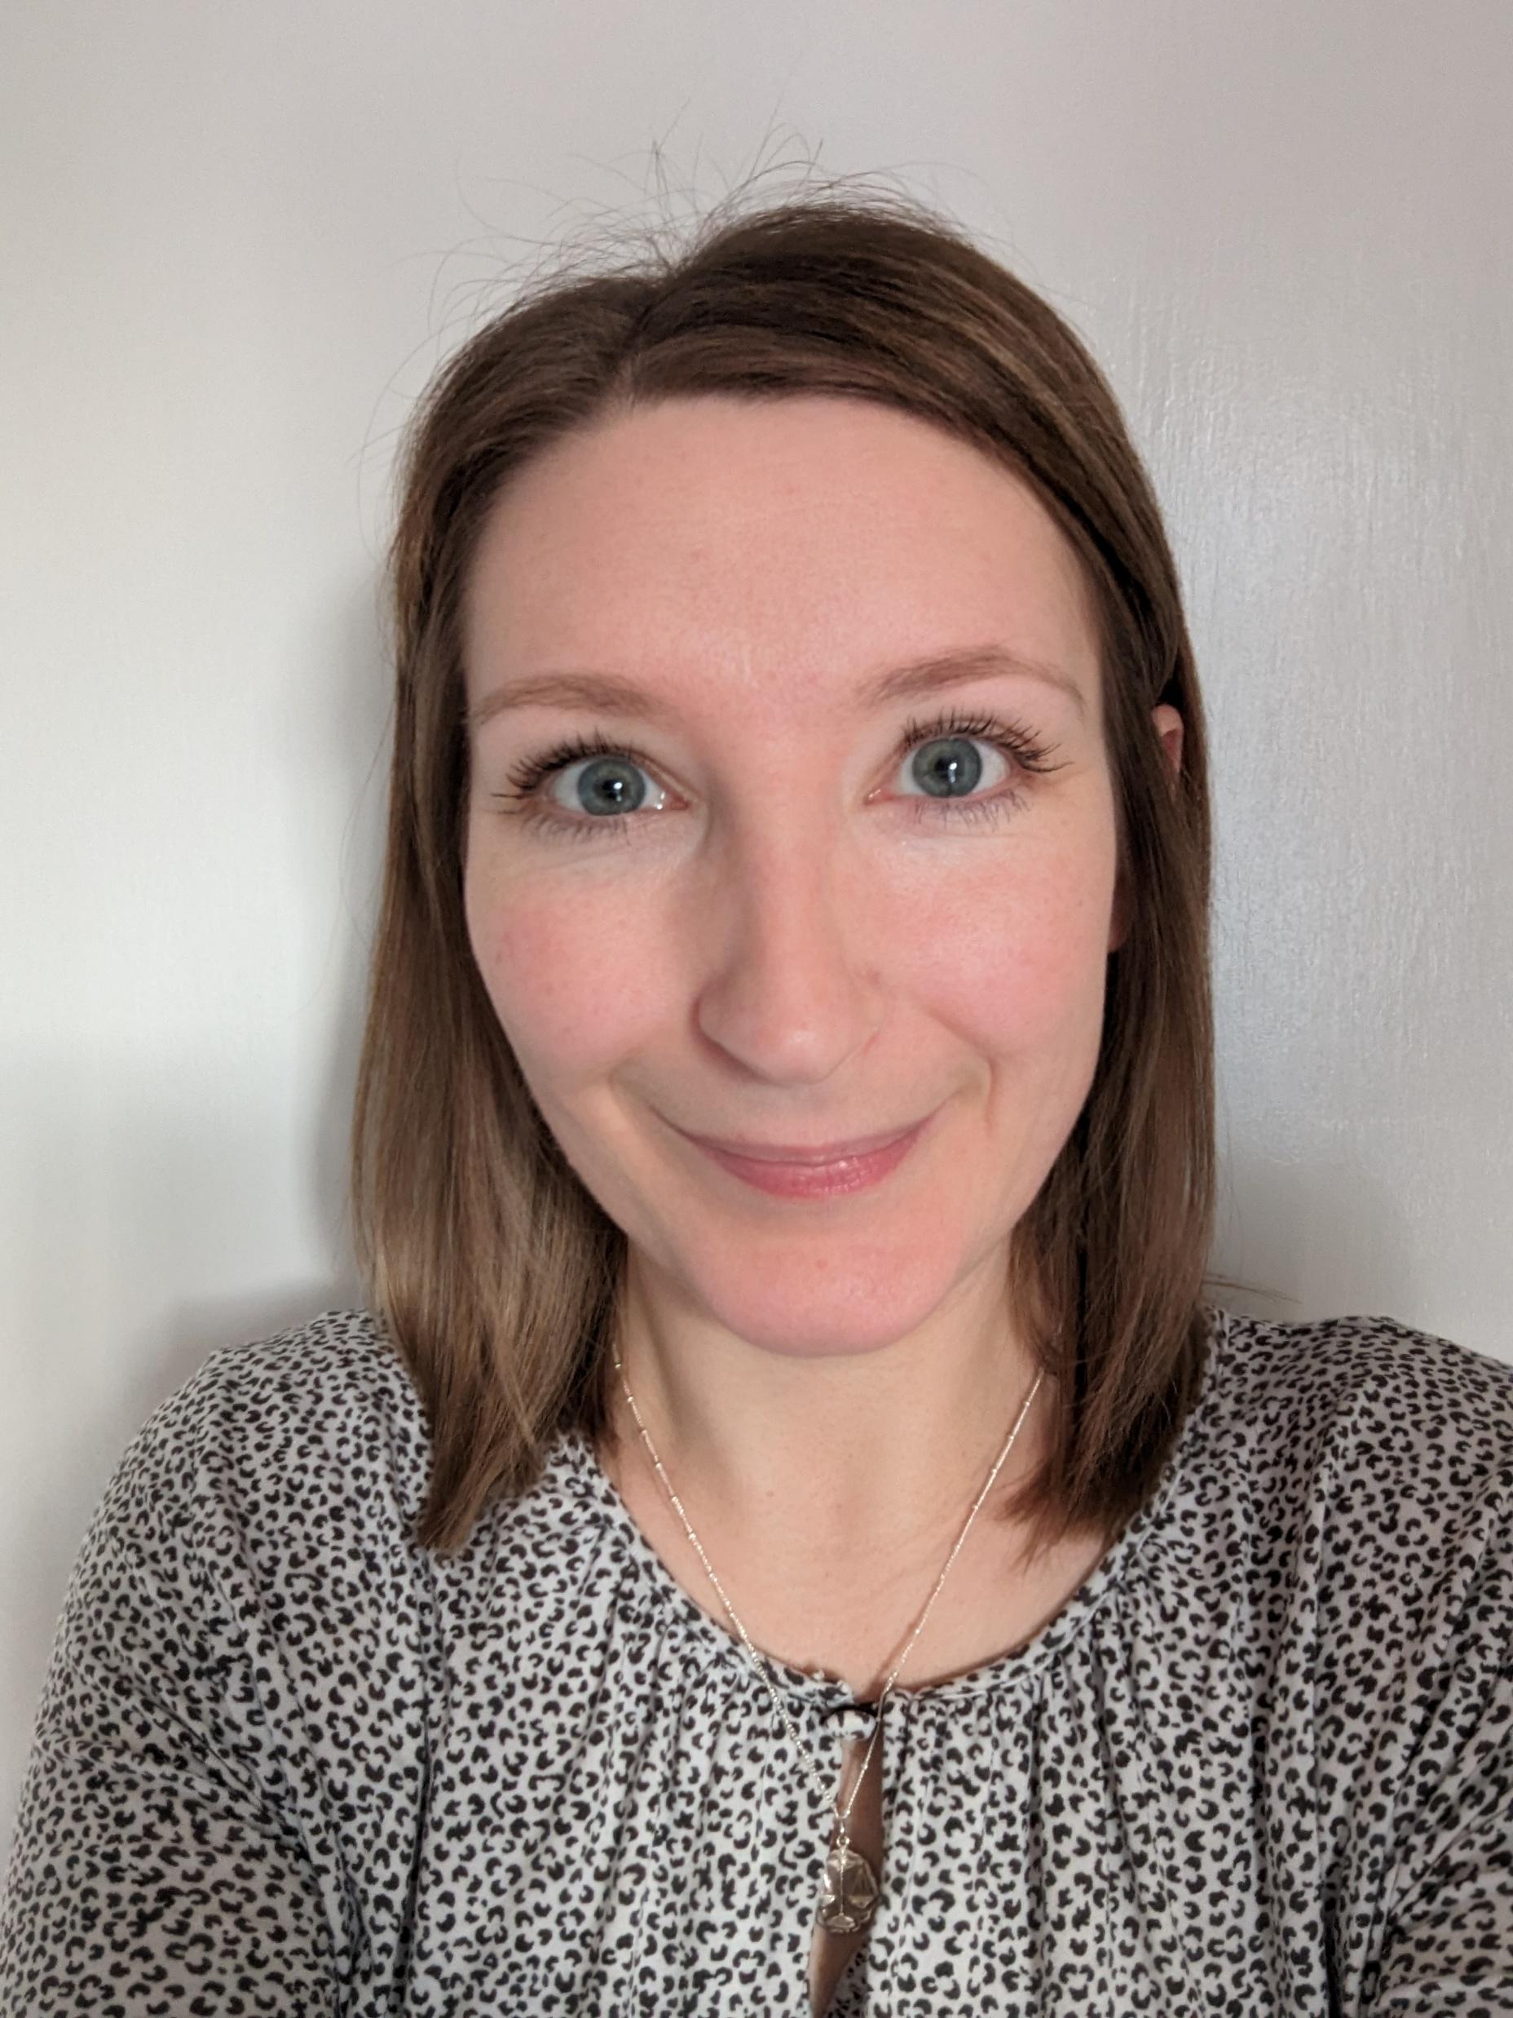
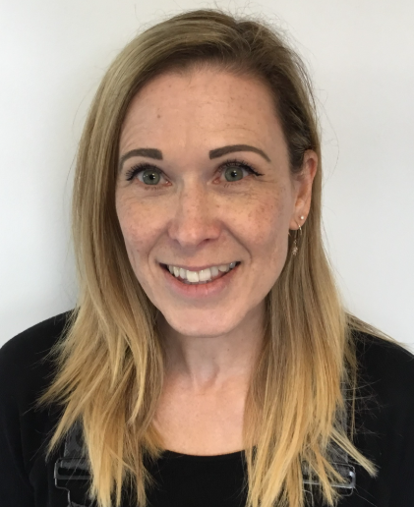
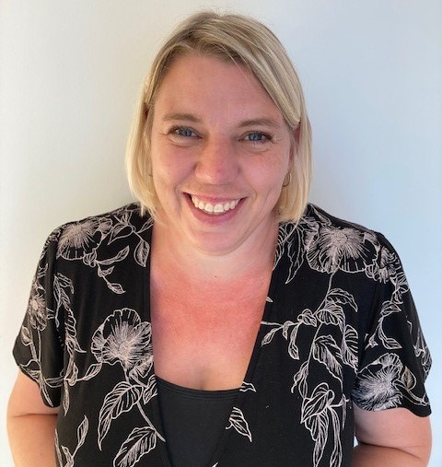
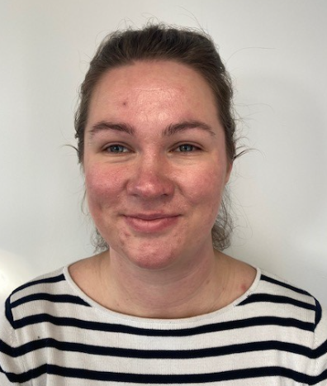
Who is in our classroom?
Mrs Mellor
Class Teacher
Assistant Principle
DSL
Mrs Mason
Teaching Assistant
Miss Rawlinson
Teaching Assistant
Mrs Hodson
Teaching Assistant
Mrs Cook
Teaching
Assistant

Slide 3
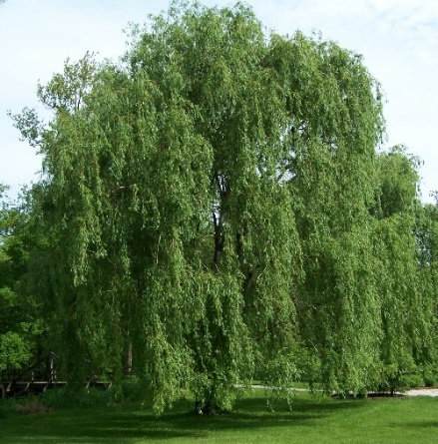
Morning Routine
T
Please drop your child on the main playground at 8.50 where they will be greeted by a member of staff. Willow class children will go straight in their classroom for their morning work. Register at 9am.
Your child will need their book bag and a labelled water bottle.
A healthy snack will be available at break time.

Slide 4

Lunchtime
WILLOW class will have lunch between 12-1.15pm.
Your child is entitled to a free school lunch each day.
If you would prefer, your child can bring in a packed lunch from home with them.

Slide 5

Home time
The children will have a daily assembly session from 3.00pm.
Children will be brought to the playground to be collected from the main gate at 3.20pm.
Your child can leave the line when a parent or carer can be clearly seen.
If someone else is collecting your child please make the office aware by telephone.

Slide 6

Timetable
WilLOW class will have daily sessions of:
Phonics and ENglish
Maths
Willow class will also have 2 PE sessions each week. These will be on a Monday and a ThuRsday (No Monday session when we have forest school).
Spellings will be sent home on MONdays and there will be a spelling test on MONday of each week.

Slide 7
Reading
reading books Will be changed on THURSDAYS
Children should bring their reading books and records in each day.
Please try to read at home daily with your child. Short, Regular sessions will help your child make progress.

Slide 8
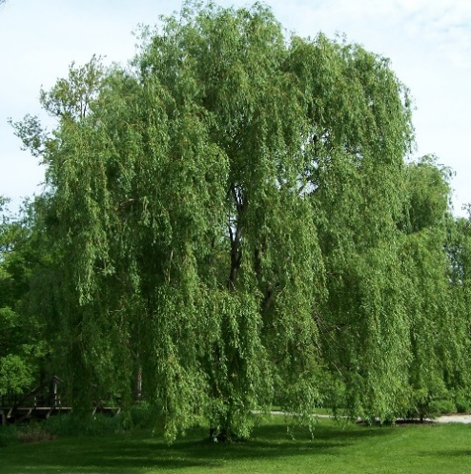
We look forward to welcoming your child into willow Class.
If you have any further questions please feel free to contact the school office or MRS Mellor.

